Slide 1
HomeSewa
Kathmandu Market Data Analysis

Slide 2
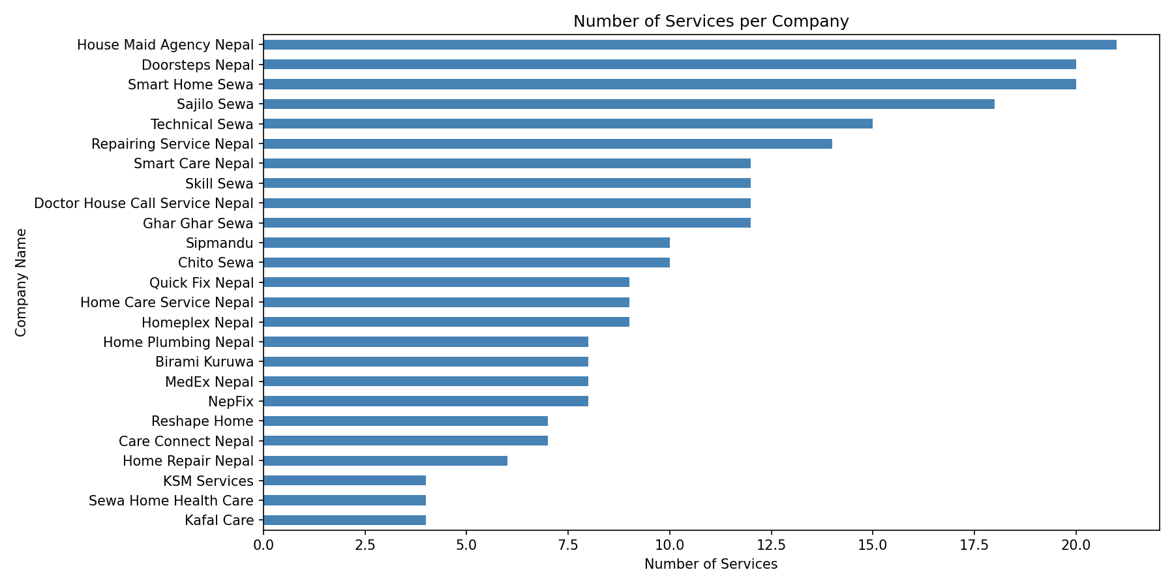
Number of services offered per company
Description: This chart compares how many distinct services each company in the Nepal home services market currently offers.
Insight: A few companies dominate with a wide service range, while most competitors offer only a handful of services.

Slide 3
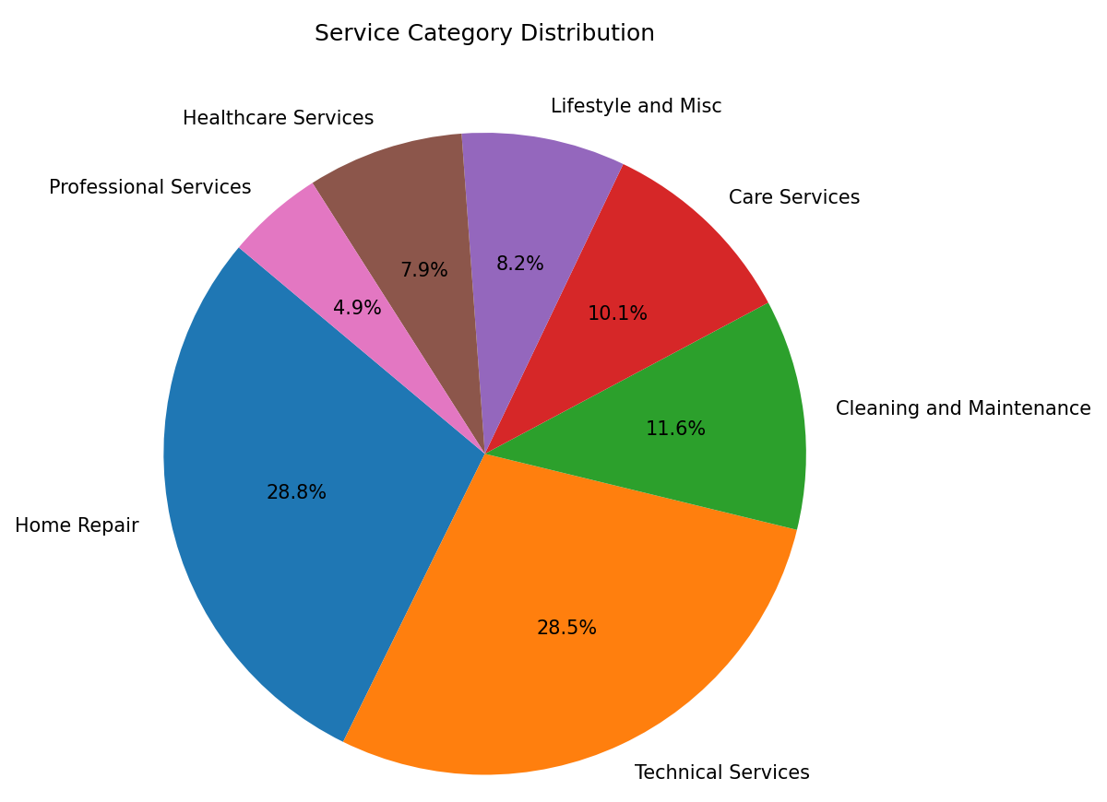
Share of total services by category
Description: This chart shows what percentage of the total service offerings falls under each service category.
Insight: A small number of categories account for the majority of all services listed in the market.

Slide 4
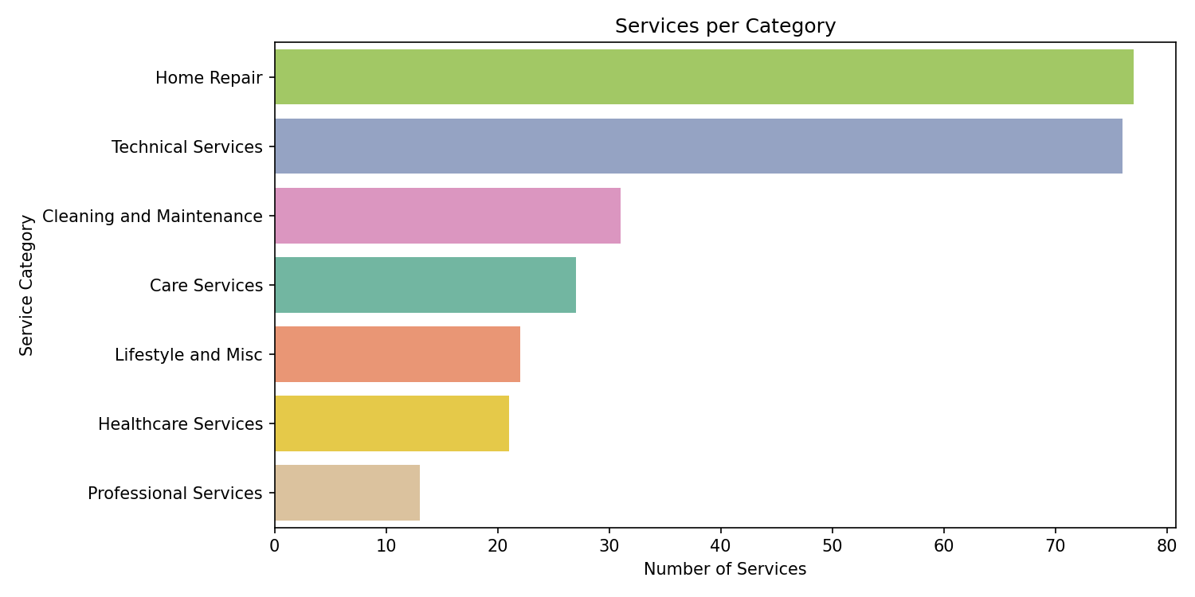
Total number of services recorded under each category
Description: This chart shows the raw count of services recorded under every individual category.
Insight: Categories like cleaning and repair have far more recorded services than niche categories.

Slide 5
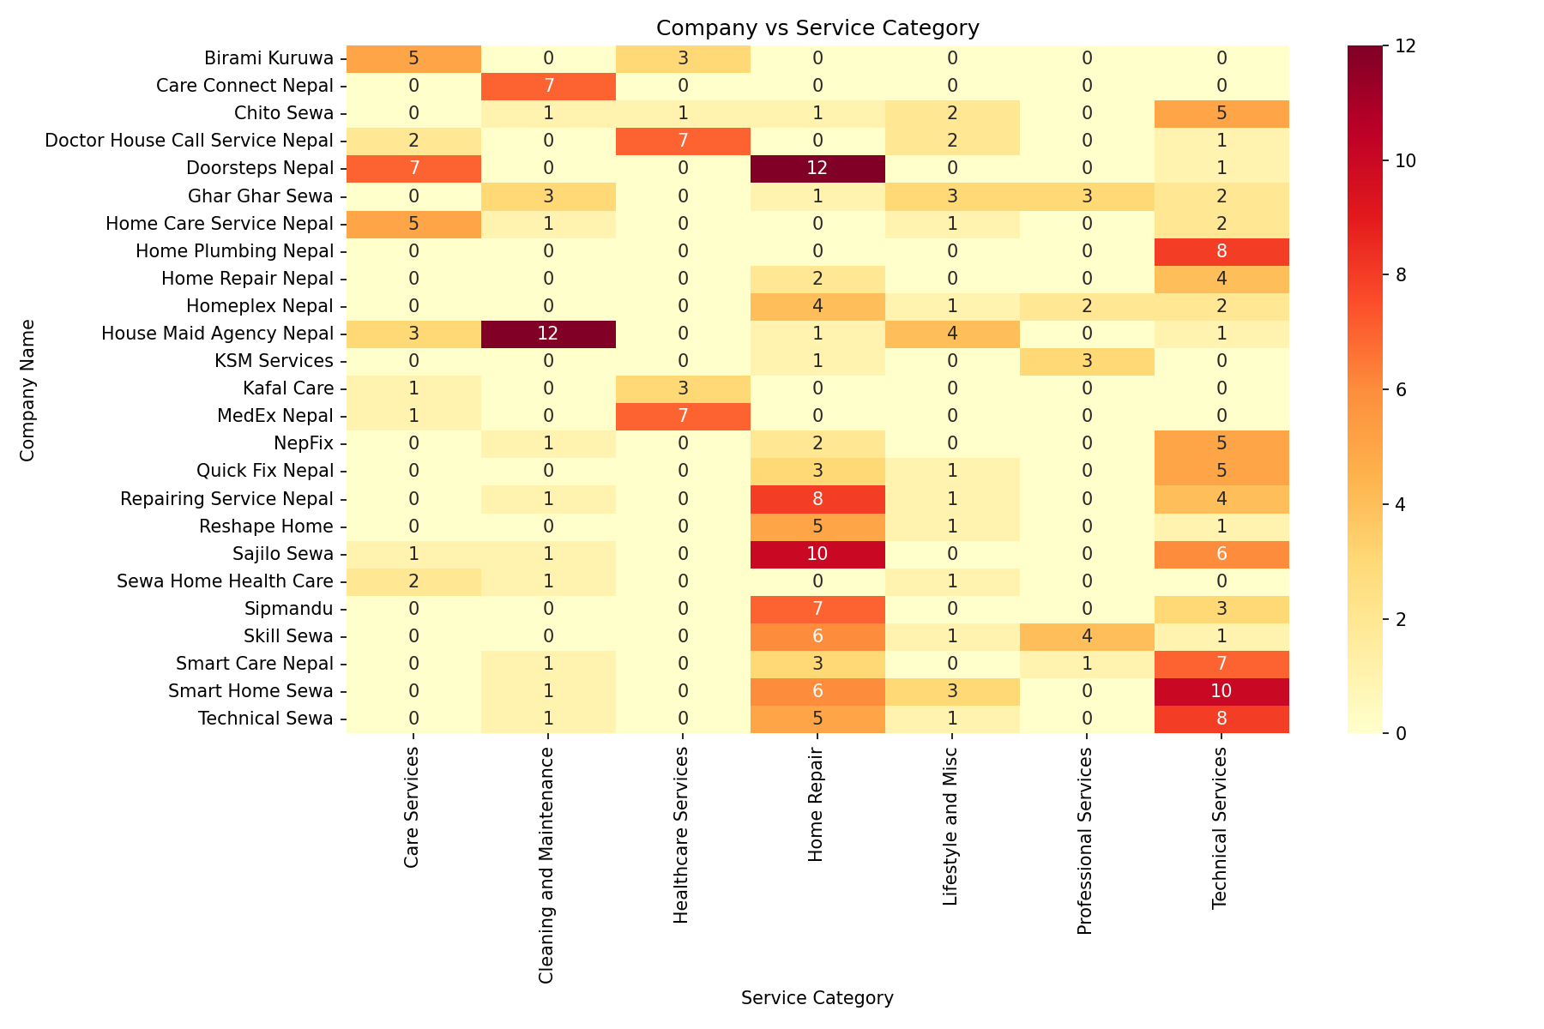
Heat map showing which companies operate in which service categories
Description: This heat map shows which companies are active in which service categories, and how concentrated that activity is.
Insight: Most companies cluster around a few common categories, leaving many categories served by only one or two players.

Slide 6
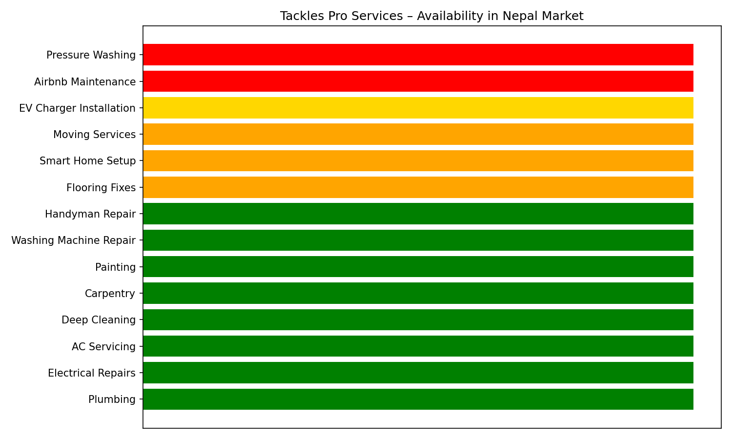
Availability of Tackles Pro Services in Nepal Market
Description: This chart shows how widely “Tackles Pro” type services are currently available across the Nepal market.
Insight: Availability is limited, pointing to a gap that could be an opportunity for new entrants.

Slide 7
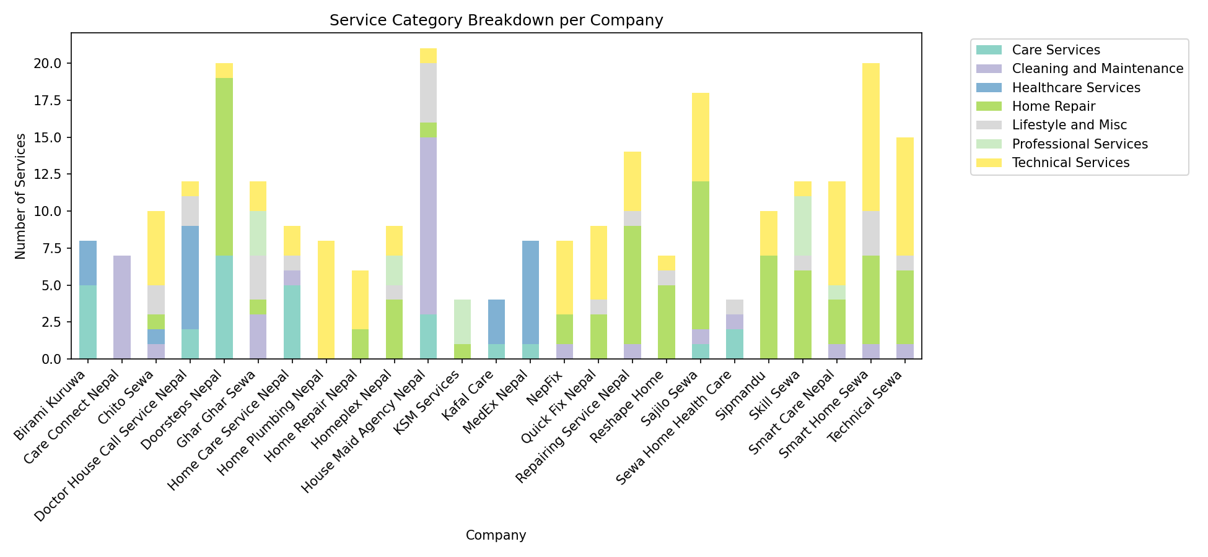
Distribution of service categories offered by each company
Description: This chart breaks down, company by company, how their offered services are spread across different categories.
Insight: Larger companies diversify across many categories, while smaller ones stay focused on one or two.

Slide 8
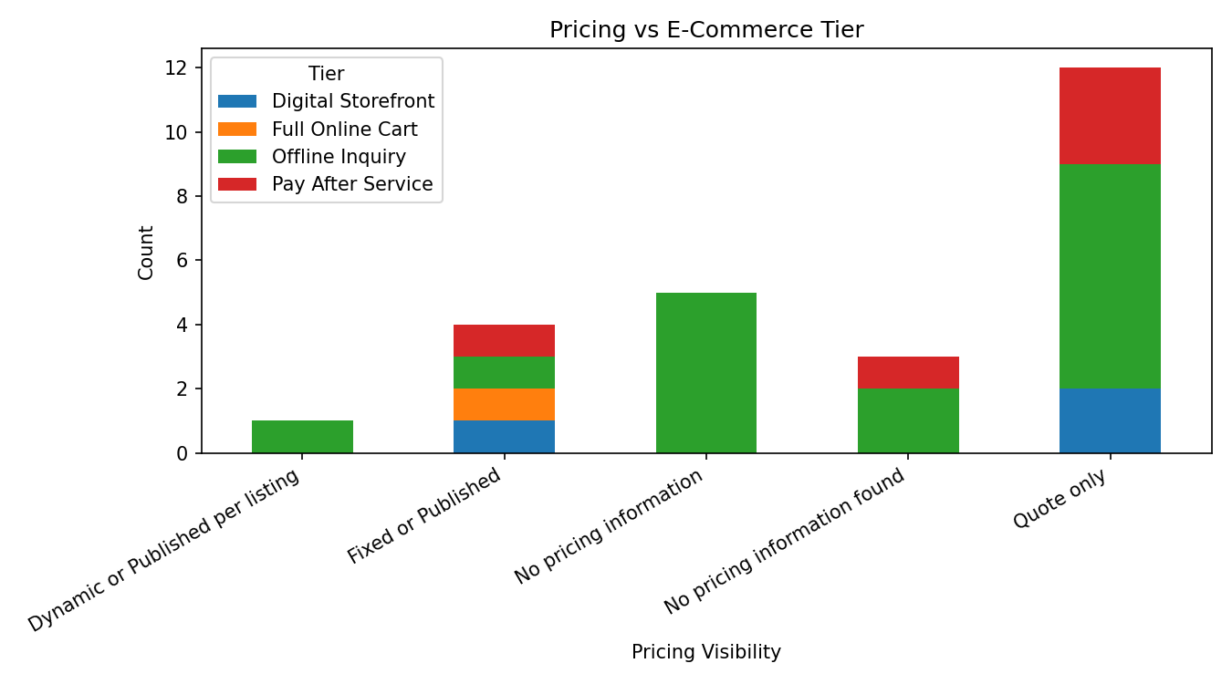
Relationship between pricing visibility and E-Commerce Tier
Description: This chart examines whether companies with clearer online pricing also tend to have stronger e-commerce presence.
Insight: Companies with higher e-commerce tiers are more likely to display transparent pricing.

Slide 9
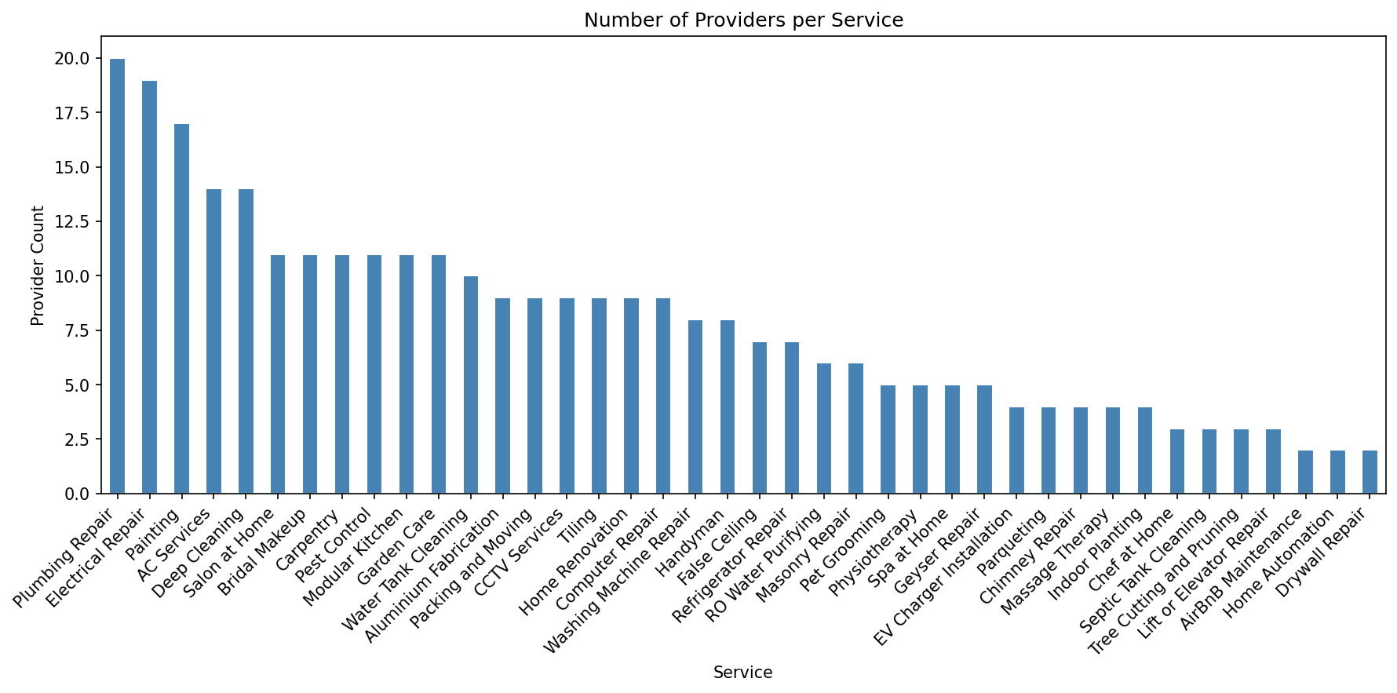
Number of providers competing in each individual service
Description: This chart shows how many providers are competing within each specific service.
Insight: Competition is heavily skewed, with a few services crowded by many providers and others nearly uncontested.

Slide 10
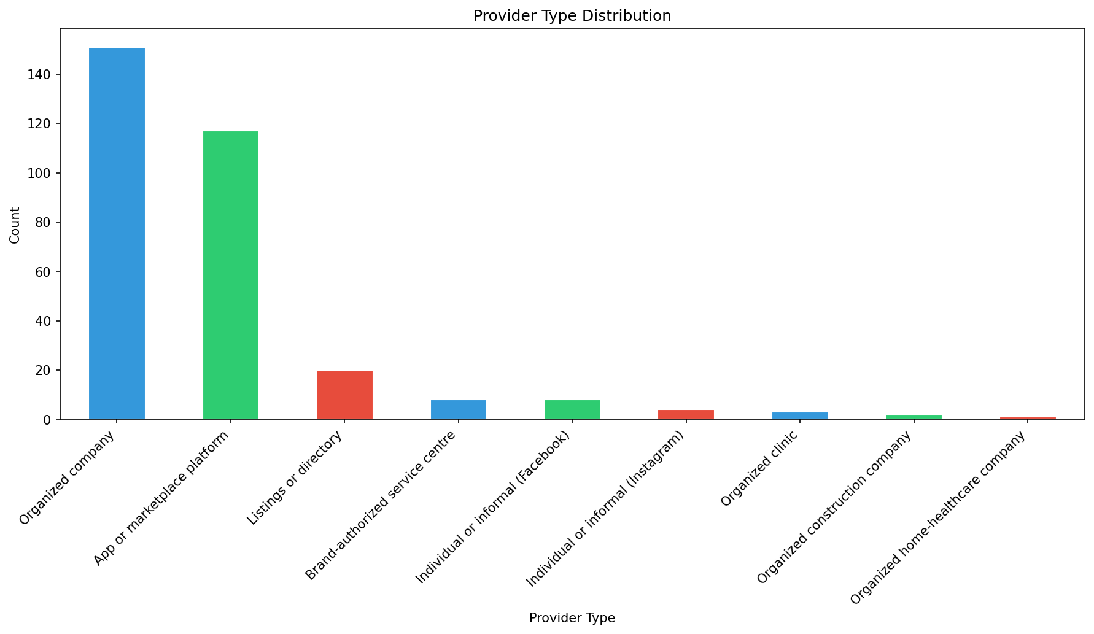
Count of providers by type
Description: This chart counts providers grouped by their business type (formal company, platform, informal or individual).
Insight: Informal and individual providers make up a large share of the overall market.

Slide 11
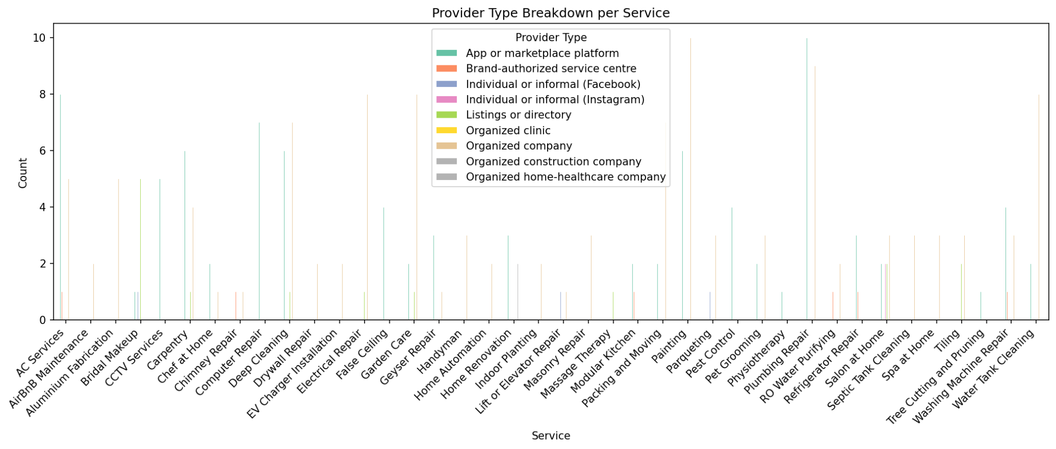
How provider types vary across different services
Description: This chart shows which provider type (formal, platform, informal) tends to dominate each service.
Insight: Formal companies dominate higher-value services, while informal providers dominate everyday household tasks.

Slide 12
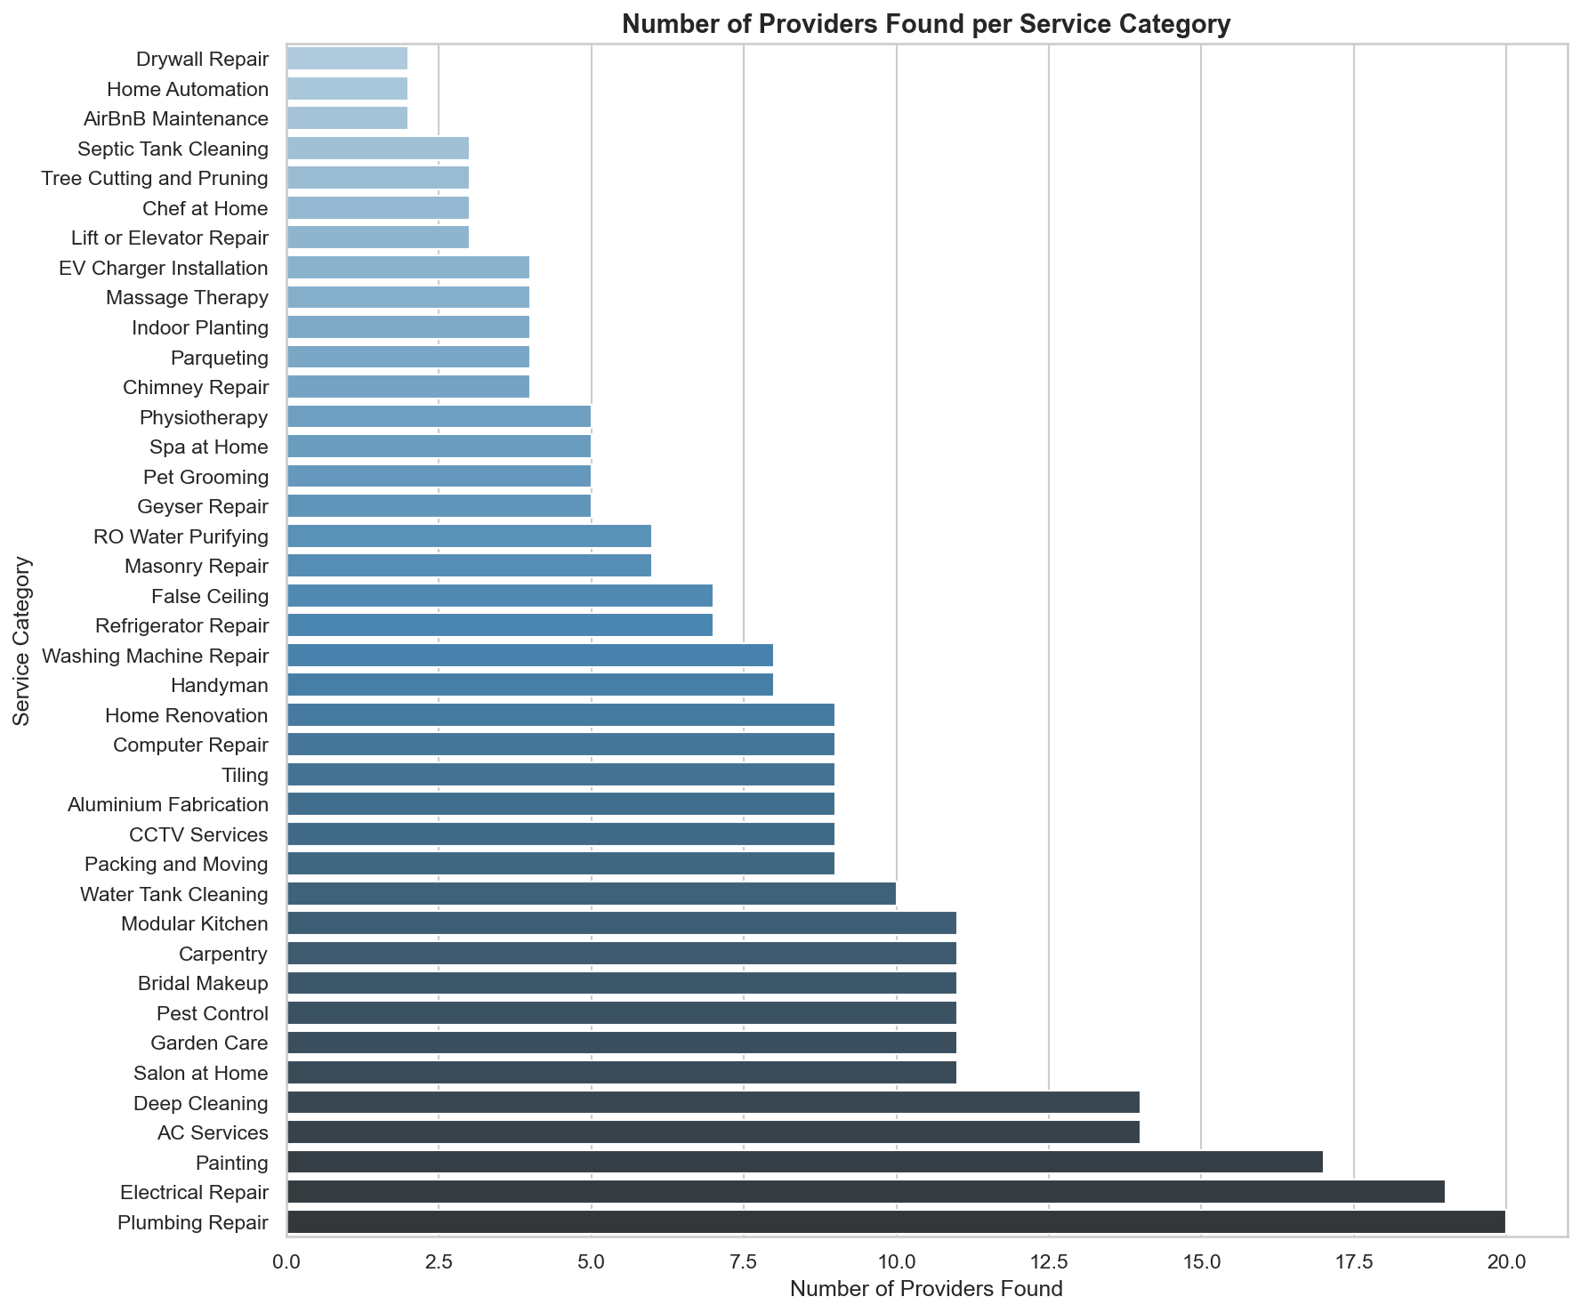
Number of providers identified per service, ranked highest to lowest
Description: This chart ranks all services by how many providers were identified for each, from most to least.
Insight: Provider supply drops off sharply after the top few services, showing a long tail of under-served services.

Slide 13
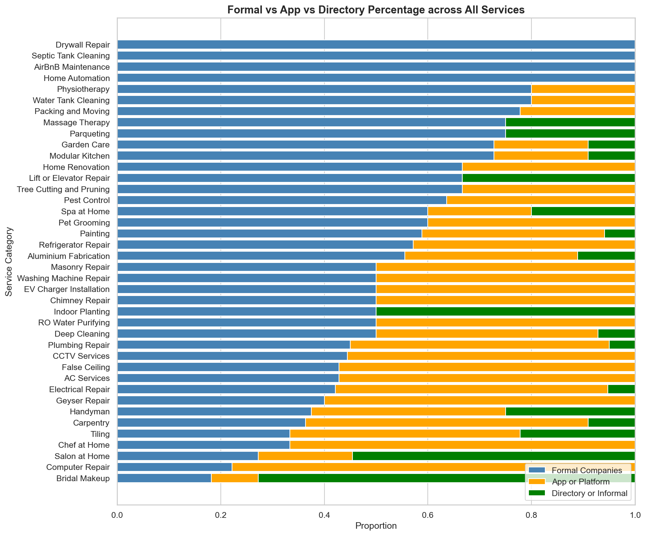
Proportion of formal companies, app or platform listings, and informal or directory listings
Description: This chart shows the overall split between formal companies, app/platform listings, and informal or directory listings.
Insight: Informal or directory-based listings still represent a significant portion of the market’s workforce presence.

Slide 14
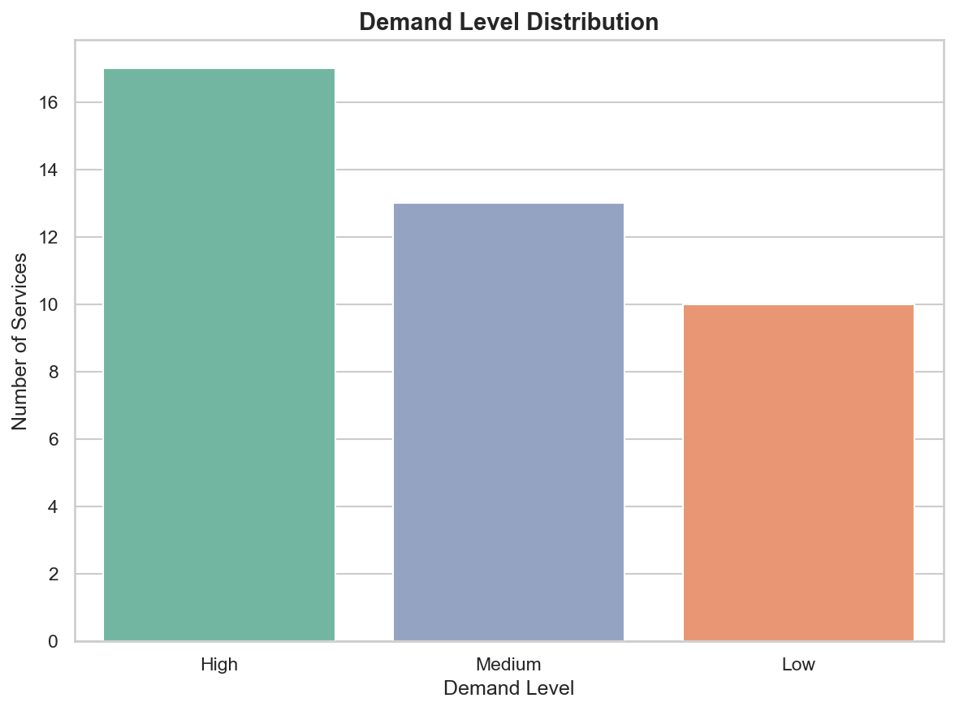
Number of services falling into High, Medium, or Low demand
Description: This chart groups all services into High, Medium, or Low demand categories based on the analysis.
Insight: A majority of services fall into the medium-demand range, with fewer at the high-demand extreme.

Slide 15
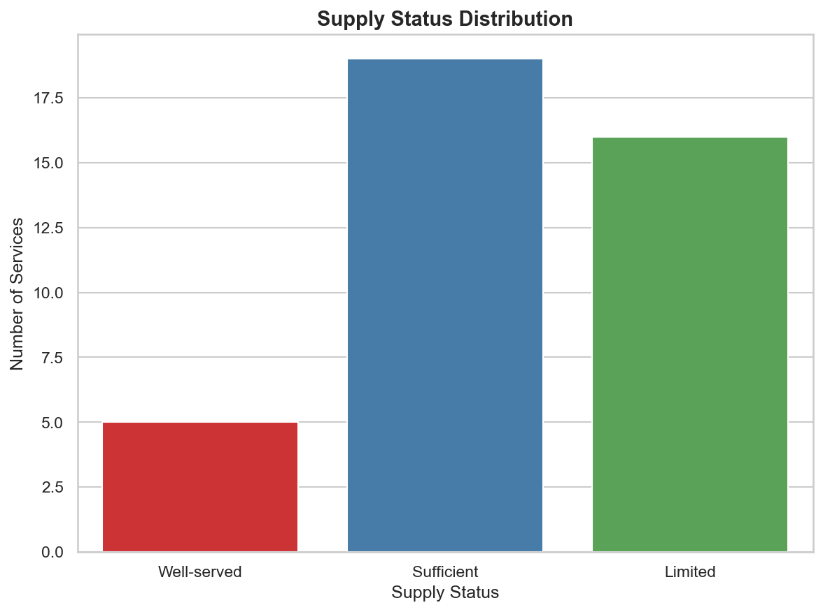
Number of services classified as Well-served, Sufficient, or Limited supply
Description: This chart classifies services by how well their current provider supply meets demand.
Insight: A notable share of services are "Limited supply," indicating room for new providers to enter.

Slide 16
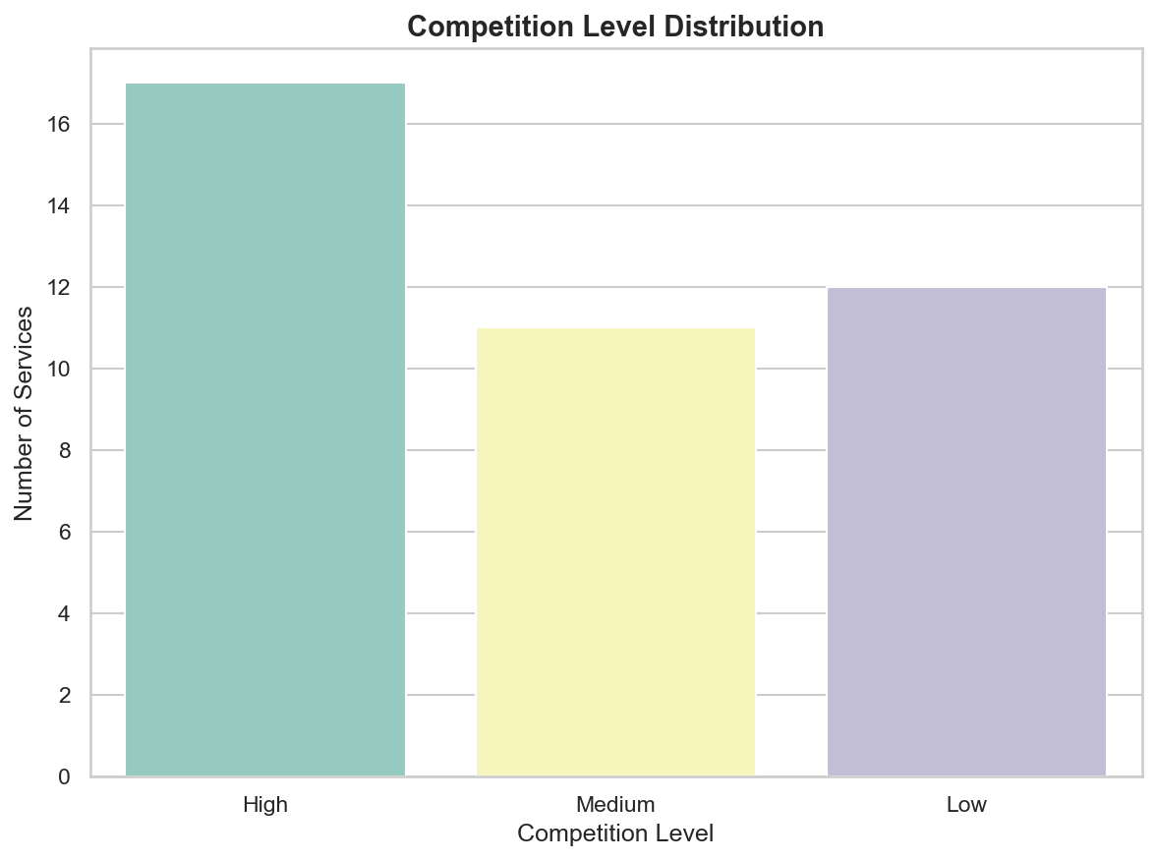
Number of services with High, Medium, or Low competition
Description: This chart groups services by their level of competition among existing providers.
Insight: Most services sit in the low-to-medium competition range, suggesting room for new entrants in many areas.

Slide 17
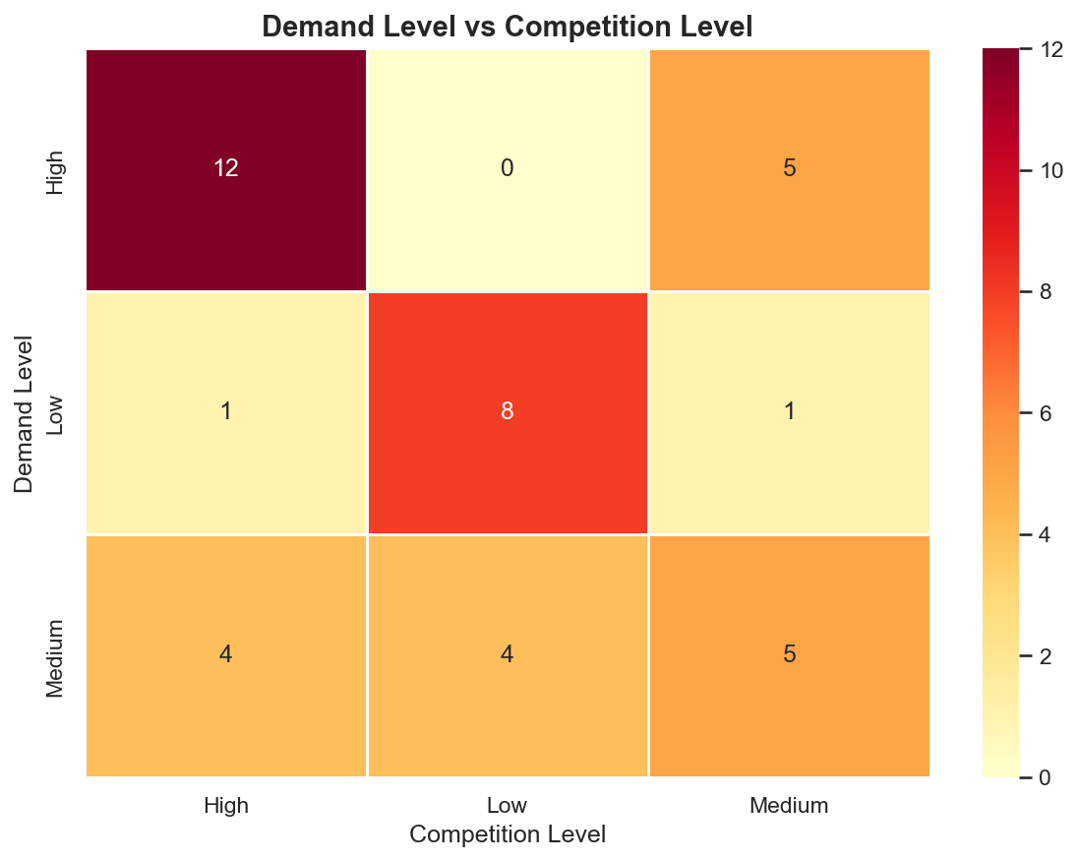
Cross-tabulation showing how demand level relates to competition level
Description: This chart cross-tabulates demand level against competition level to spot where demand outpaces competition.
Insight: Several high-demand services still show low competition, marking them as strong opportunity areas.

Slide 18
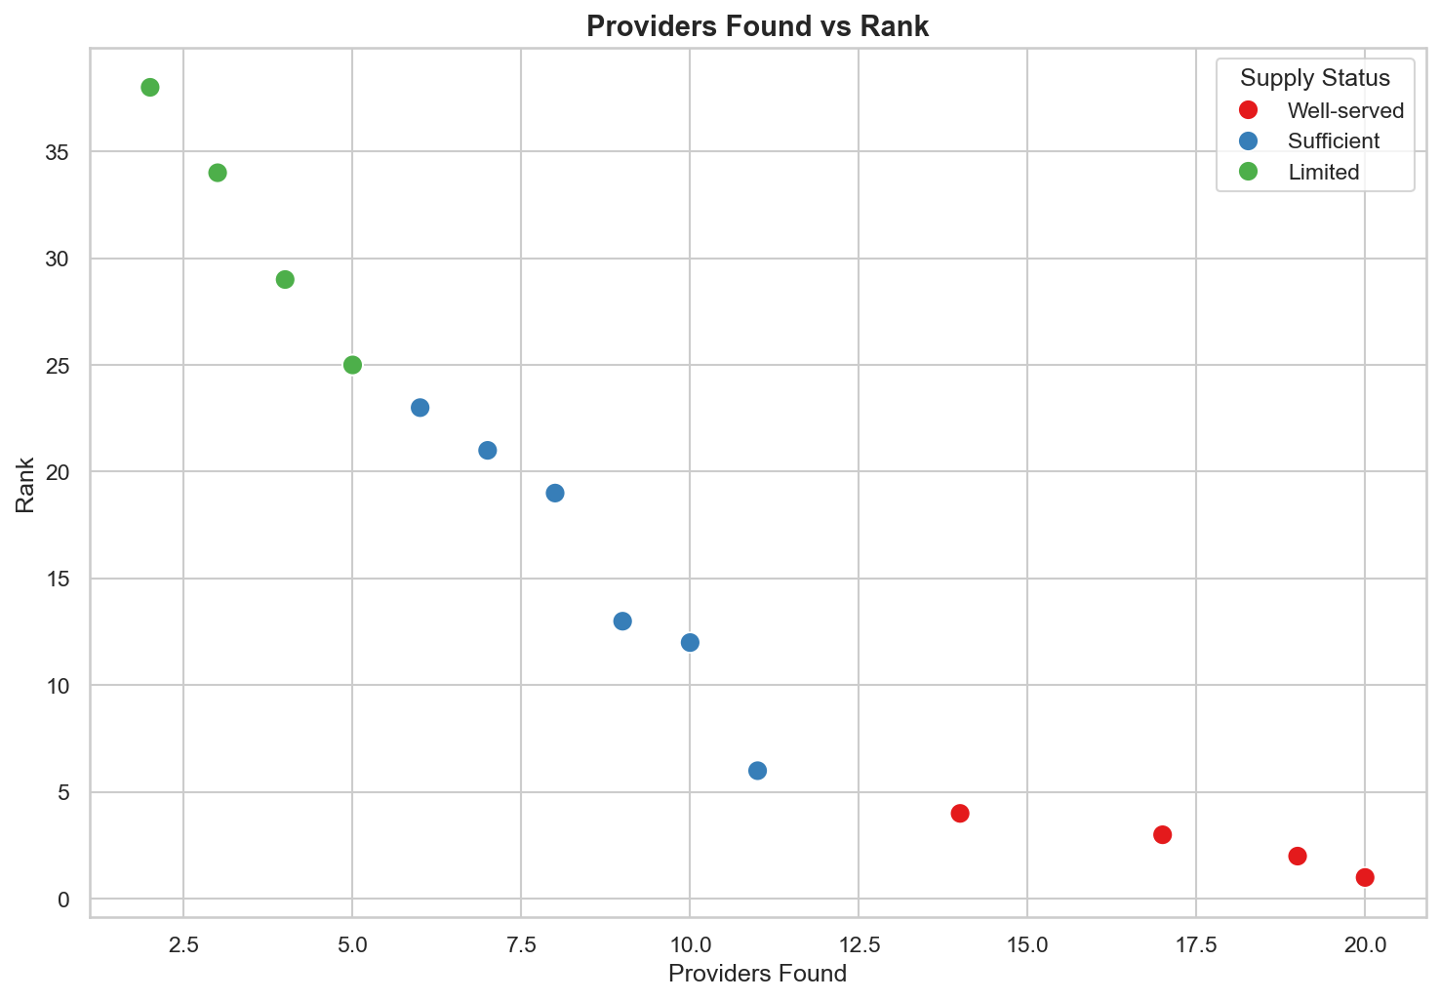
Relationship between number of providers found and their supply-status ranking
Description: This chart plots the number of providers found for each service against its supply-status ranking.
Insight: Services with fewer providers consistently rank lower on supply status, confirming supply gaps are provider-driven.

Slide 19
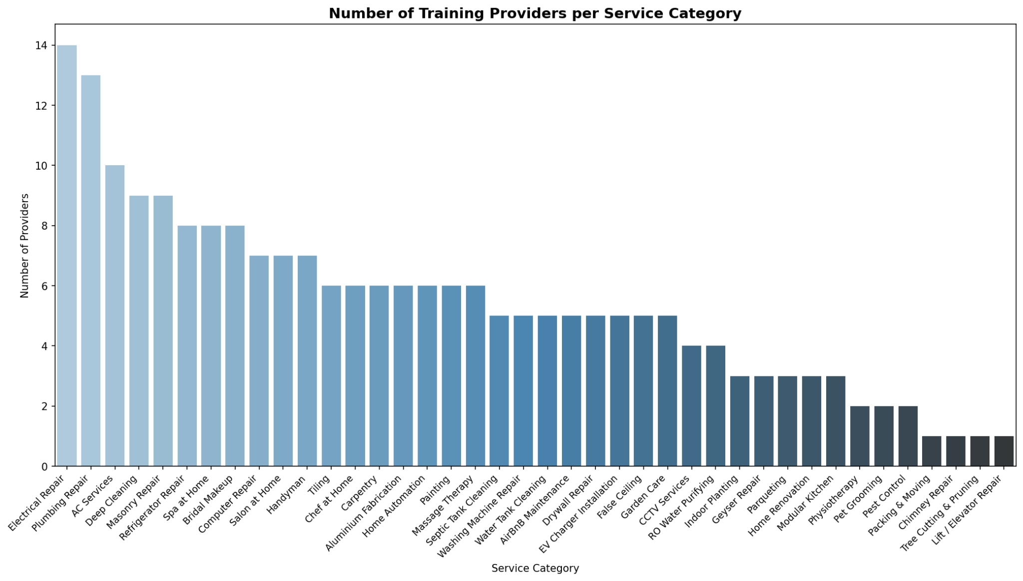
Number of training providers available for each service category
Description: This chart shows how many training providers exist for each service category.
Insight: Training availability is concentrated in a few popular categories, leaving many categories without formal training options.

Slide 20
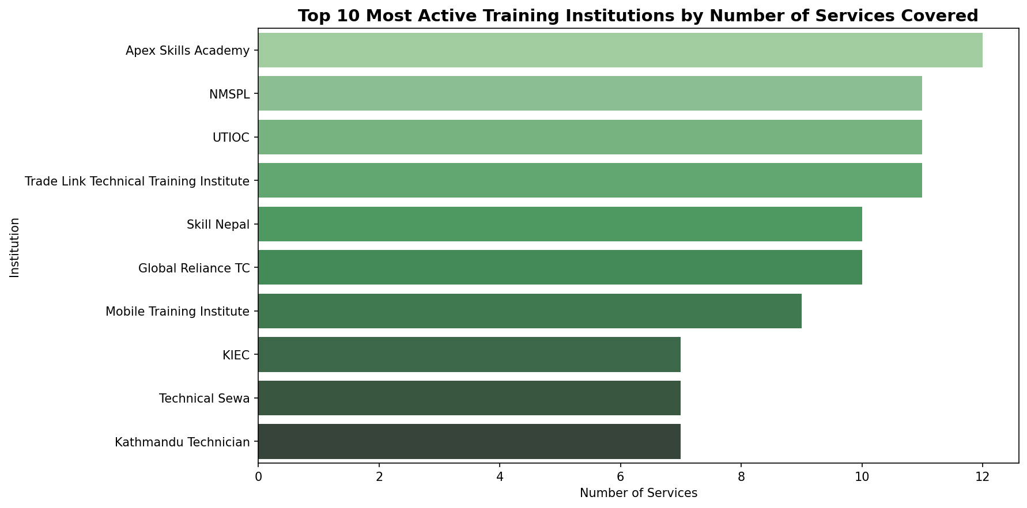
Most active training institutions ranked by number of services covered
Description: This chart ranks training institutions by how many different services they provide training for.
Insight: A small set of institutions cover the majority of trainable services, indicating low diversity among training providers.

Slide 21
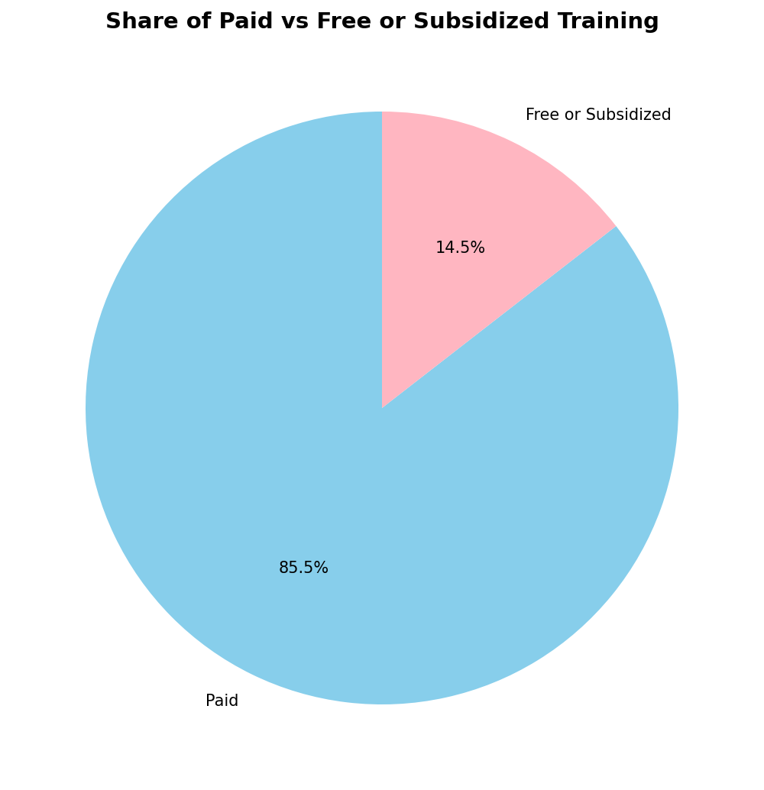
Share of training programs that are paid vs. free or subsidized
Description: This chart shows what proportion of training programs are paid compared to free or subsidized.
Insight: Paid training programs make up the larger share, which may limit access for lower-income workers.

Slide 22
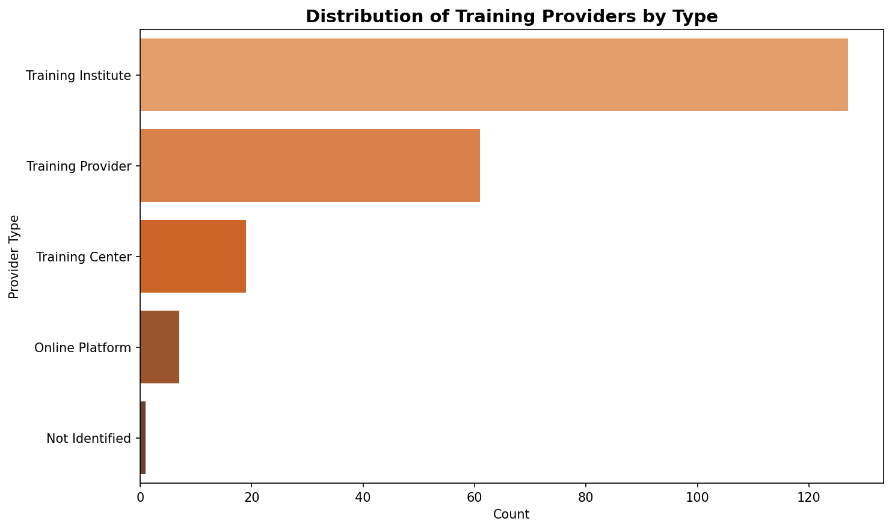
Breakdown of training providers by type
Description: This chart breaks down training providers by type, such as government, private, or NGO.
Insight: Private training providers form the largest group, with government and NGO options comparatively limited.

Slide 23
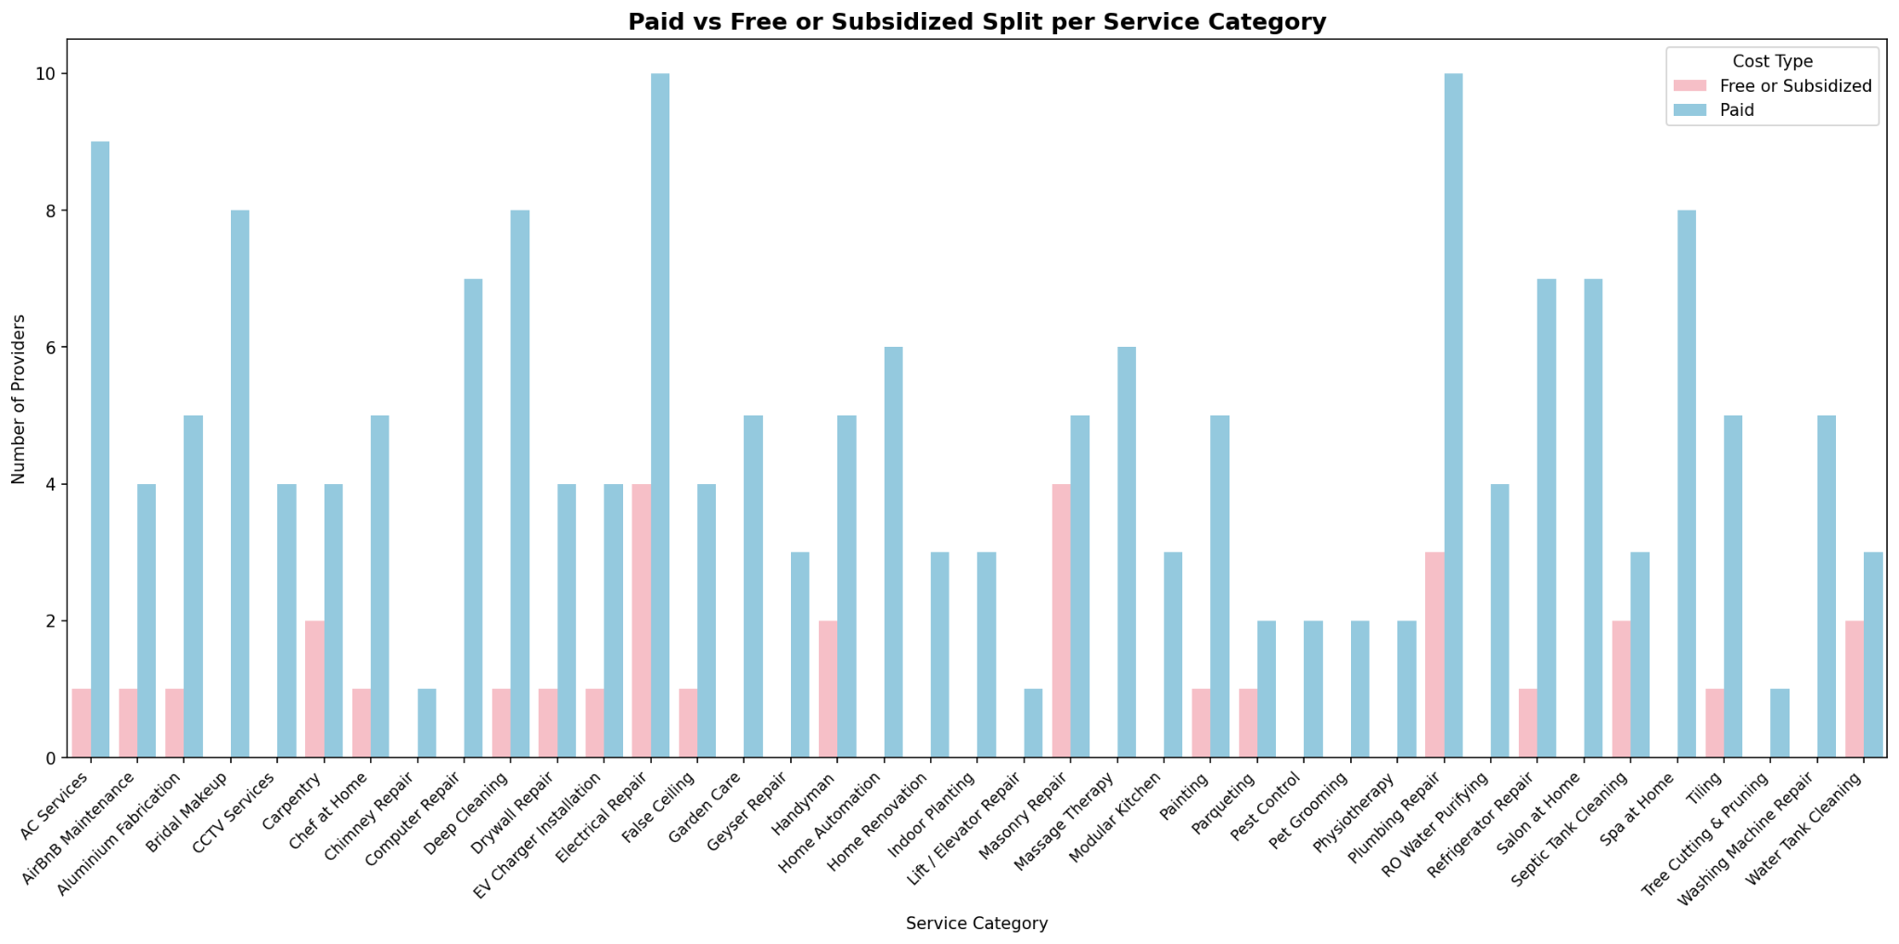
Paid vs. free or subsidized training split shown by service category
Description: This chart shows the paid versus free or subsidized training split within each individual service category.
Insight: Free or subsidized training is more common in essential service categories than in specialized ones.

Slide 24
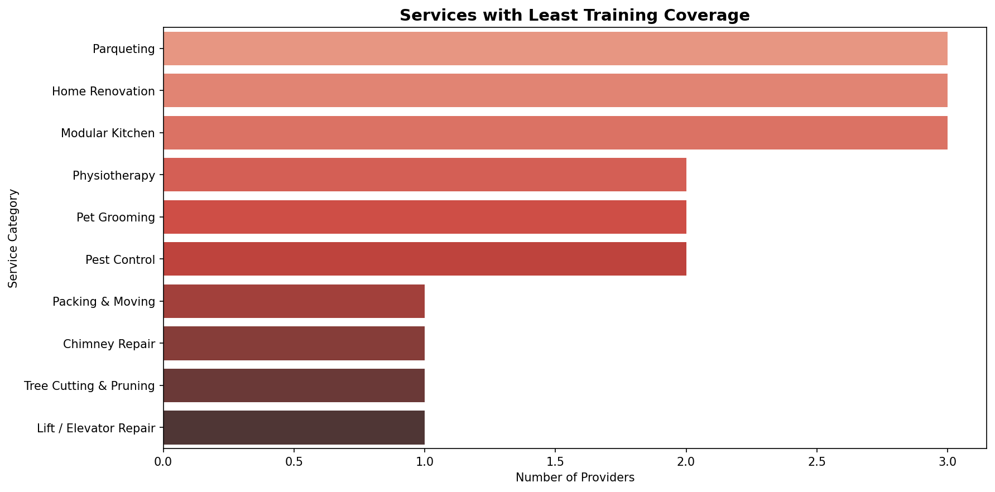
Extent of training availability mapped across service categories
Description: This chart maps how extensively training is available across all service categories.
Insight: Several service categories show little to no training availability, signaling a clear skills-development gap.

Slide 25
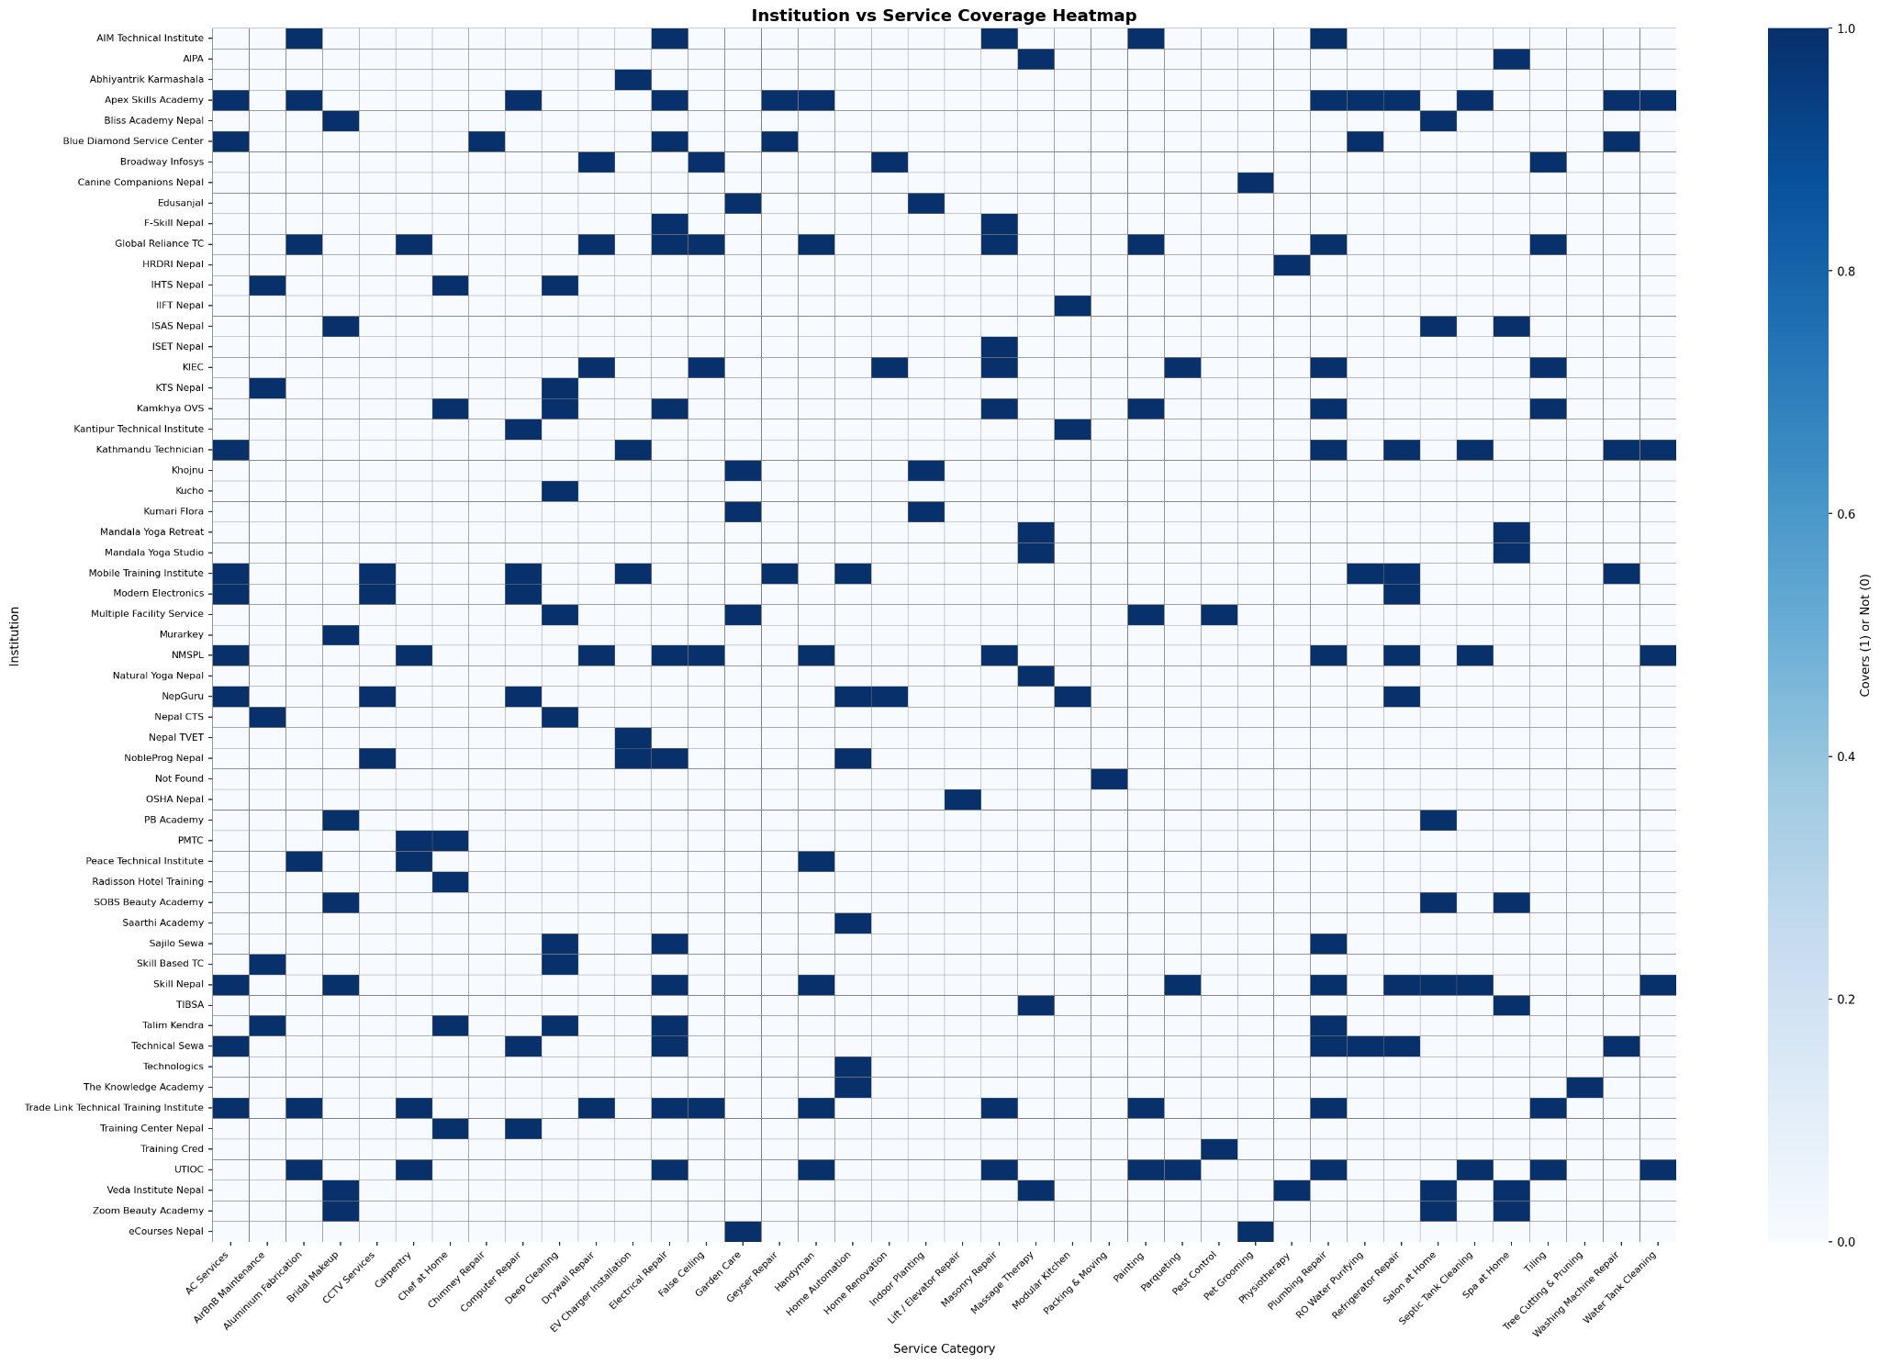
Heatmap showing which training institutions cover which service categories
Description: This heat map shows which training institutions offer training for which service categories.
Insight: Coverage overlaps heavily among top institutions, while niche categories are left largely untrained.

Slide 26
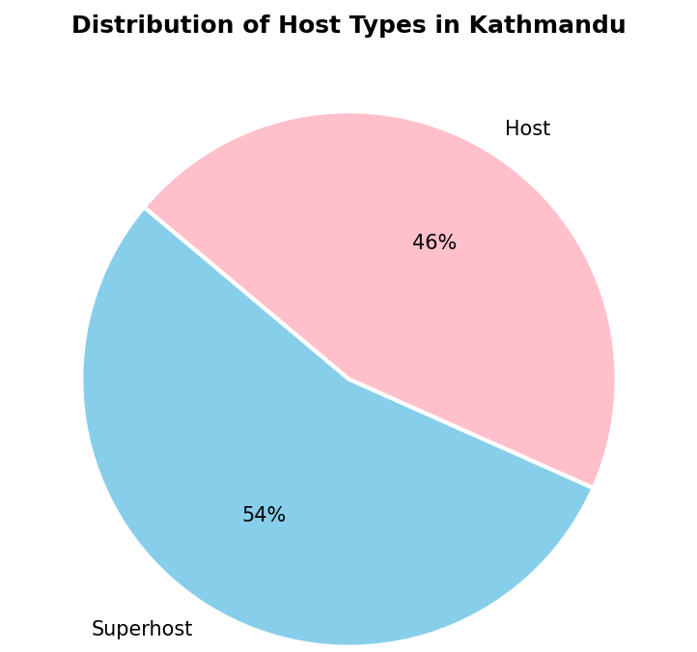
Share of Superhosts vs regular Hosts in Kathmandu
Description: This chart shows the proportion of Superhosts compared to regular Hosts operating in Kathmandu.
Insight: Superhosts remain a minority, meaning most listings are still run by regular, non-Superhost hosts.

Slide 27
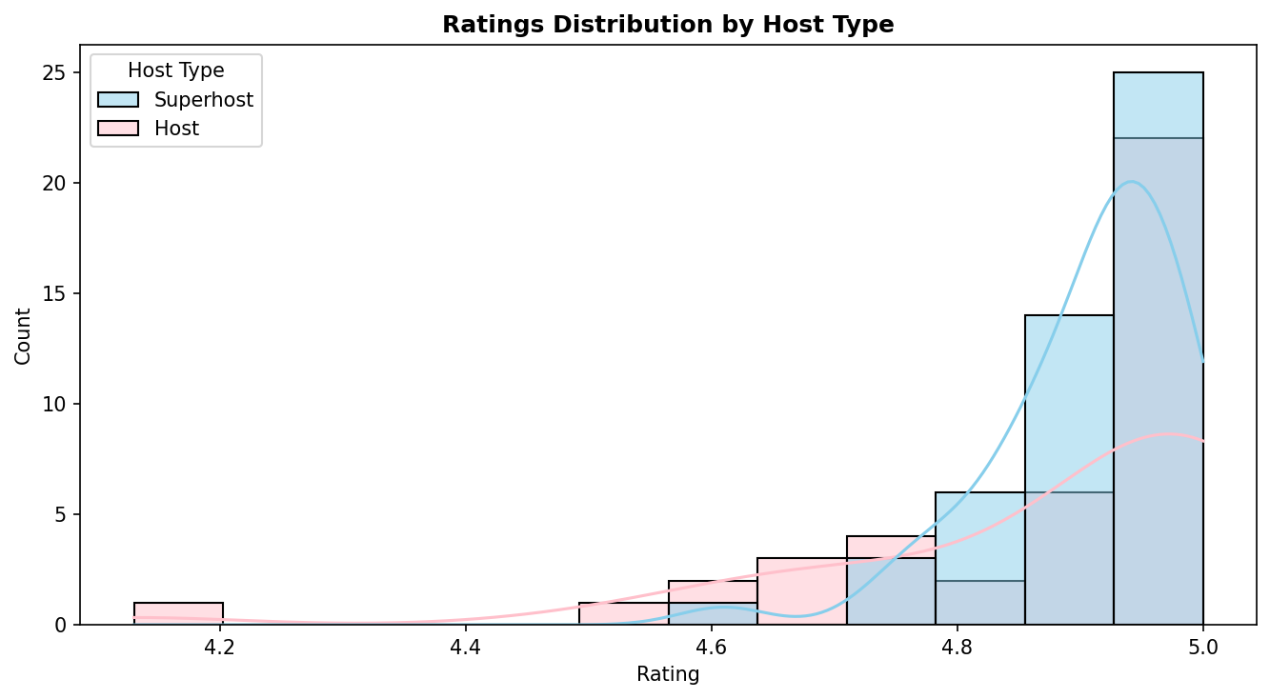
Spread of guest ratings comparing Superhosts and Hosts
Description: This chart compares the distribution of guest ratings between Superhosts and regular Hosts.
Insight: Superhosts consistently cluster at higher ratings, while regular Hosts show a wider, more mixed spread.

Slide 28
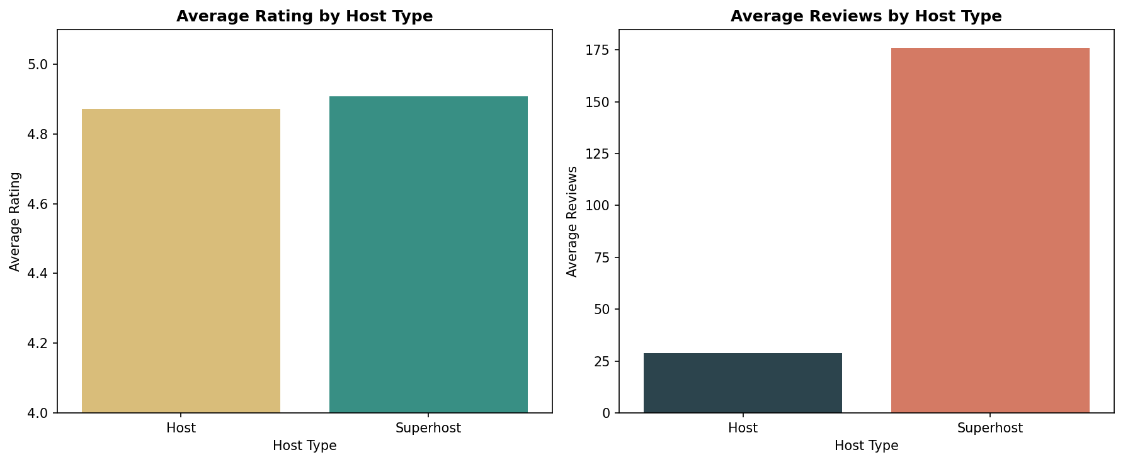
Average rating and average review count compared between Superhosts and Hosts
Description: This chart compares the average rating and average number of reviews for Superhosts versus Hosts.
Insight: Superhosts hold both higher average ratings and higher review counts, reflecting stronger guest trust.

Slide 29
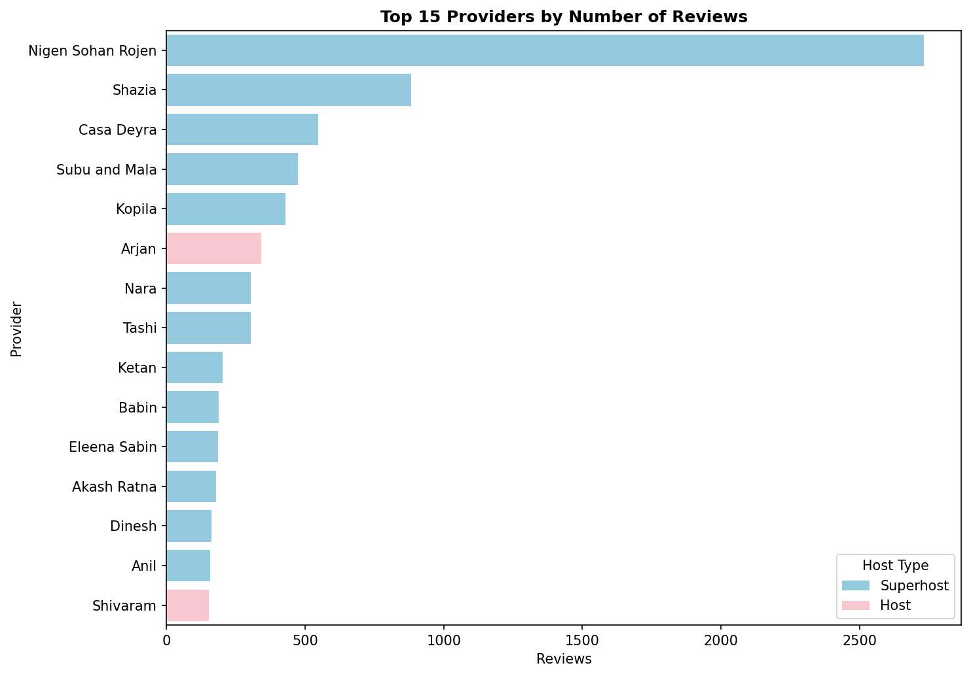
Highest-reviewed individual hosts, color-coded by host type
Description: This chart highlights the individual hosts with the most reviews, color-coded by whether they are a Superhost or Host.
Insight: Superhosts dominate the top of the review-count ranking, reinforcing their stronger market presence.

Slide 30
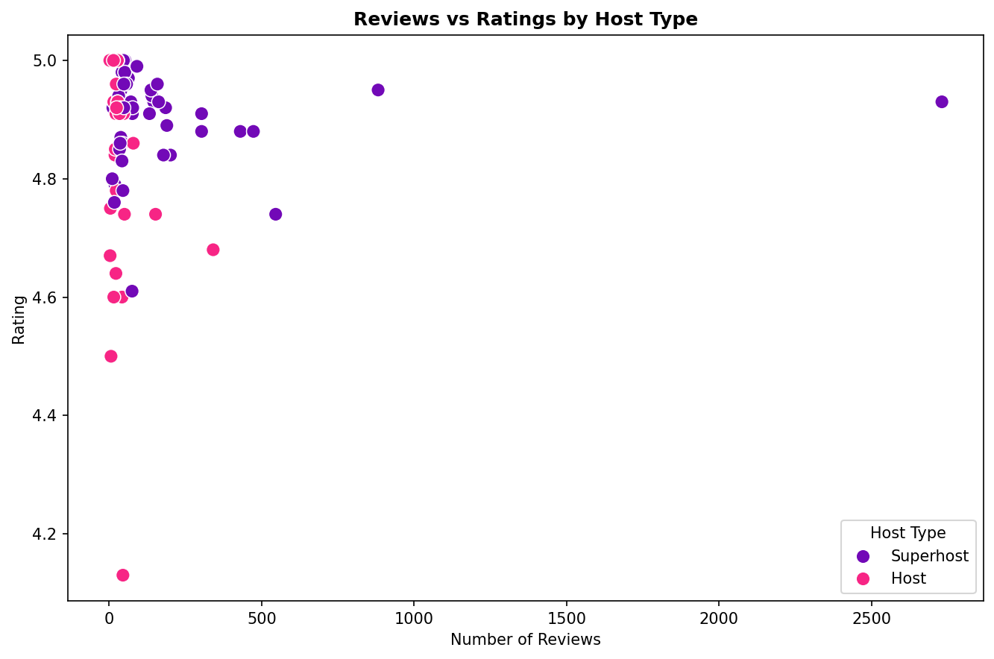
Correlation between number of reviews and rating score, by host type
Description: This chart examines whether a higher number of reviews correlates with a higher rating, split by host type.
Insight:More reviews do not strongly guarantee higher ratings, but Superhosts maintain high ratings regardless of review volume.

Slide 31
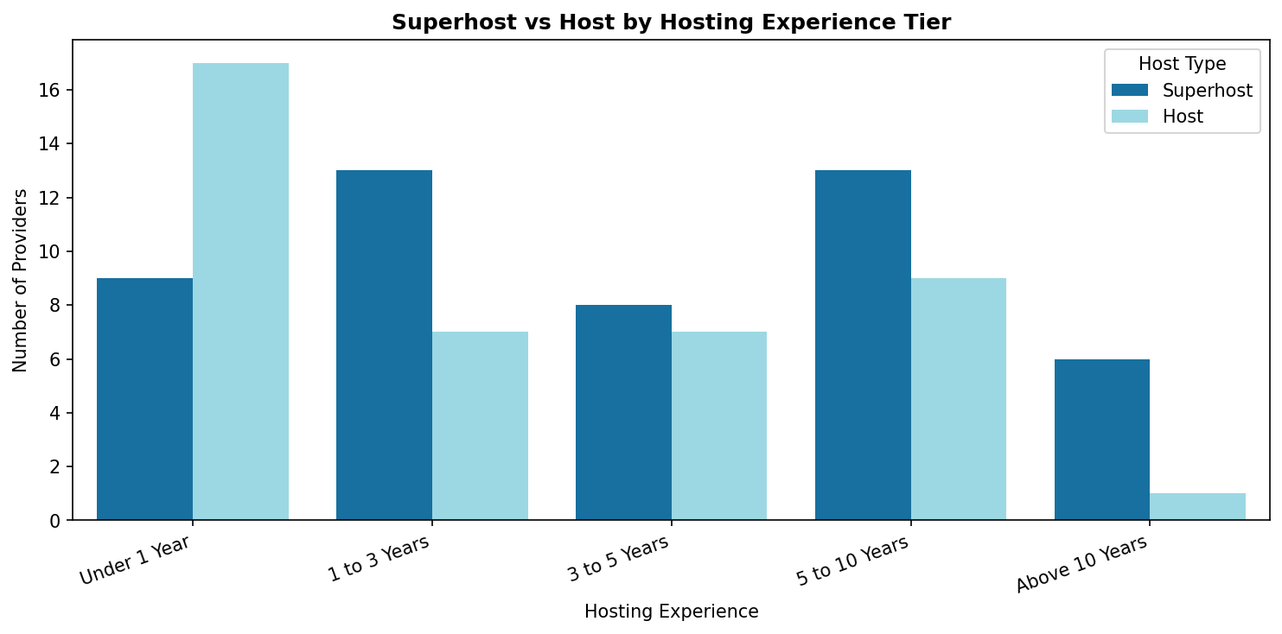
Number of providers in each hosting-experience tier, split by host type
Description: This chart groups hosts into experience tiers and shows how Superhosts and Hosts are distributed across them.
Insight: Superhost status becomes more common at higher experience tiers, suggesting it's earned over time.

Slide 32
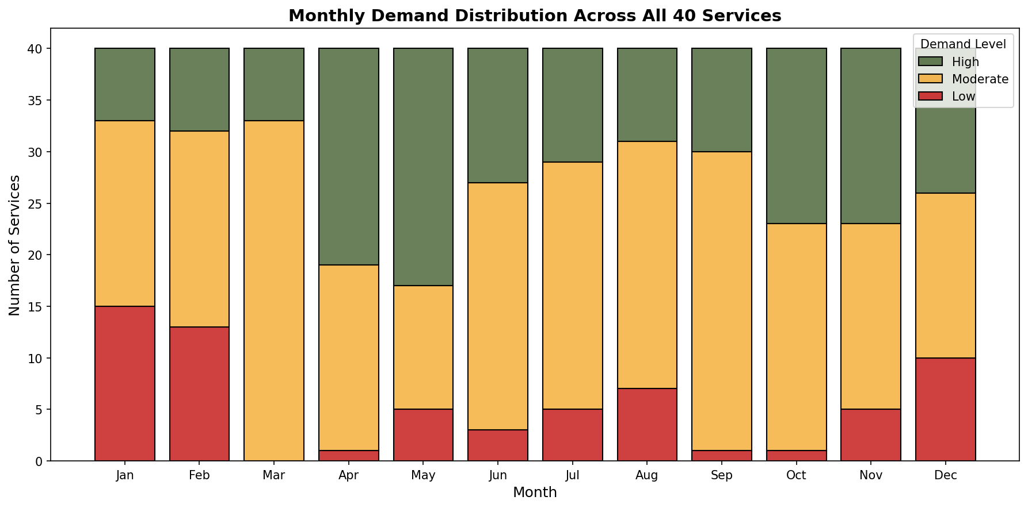
Number of services with High, Moderate and Low demand across each month of the year
Description: This chart tracks how many services fall into High, Moderate, or Low demand for each month of the year.
Insight: Demand peaks in specific months, revealing clear seasonal cycles rather than steady year-round demand.

Slide 33
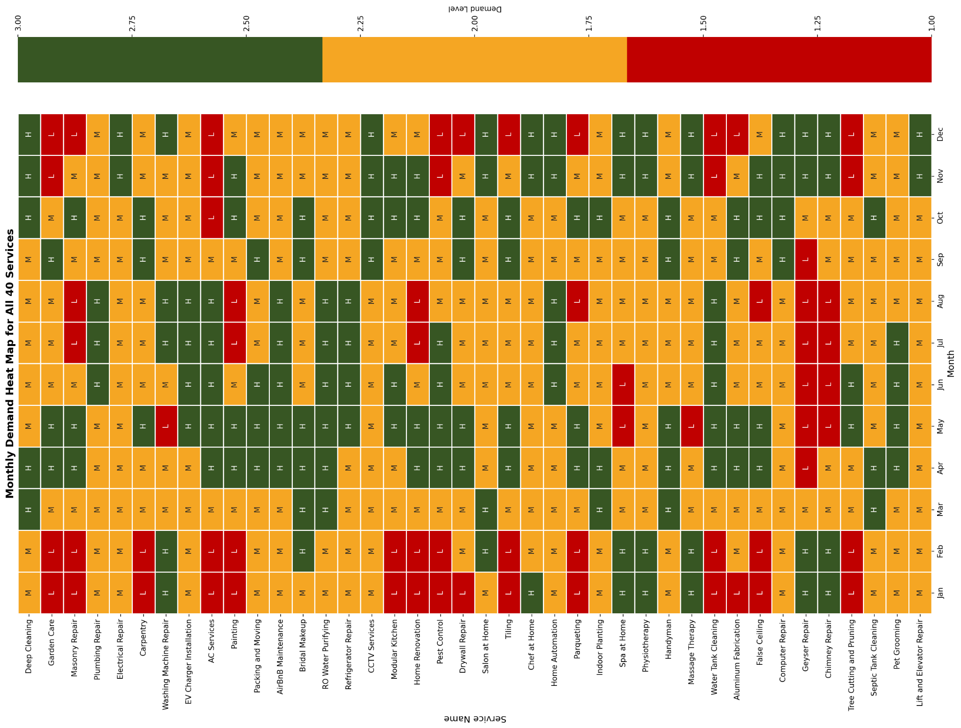
Demand level for all 40 services mapped month-by-month
Description: This chart maps the demand level of all 40 tracked services across every month of the year.
Insight: Different services peak at different times, showing that seasonality varies significantly by service type.

Slide 34
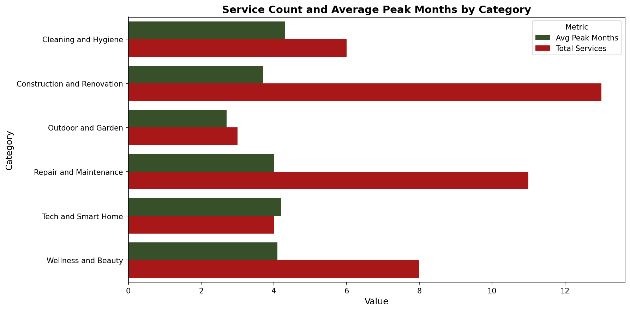
Total services and average number of peak-demand months per category
Description: This chart shows how many services exist per category and how many months, on average, each category experiences peak demand.
Insight: Some categories have short, intense demand peaks while others sustain moderate demand for longer stretches.

Slide 35
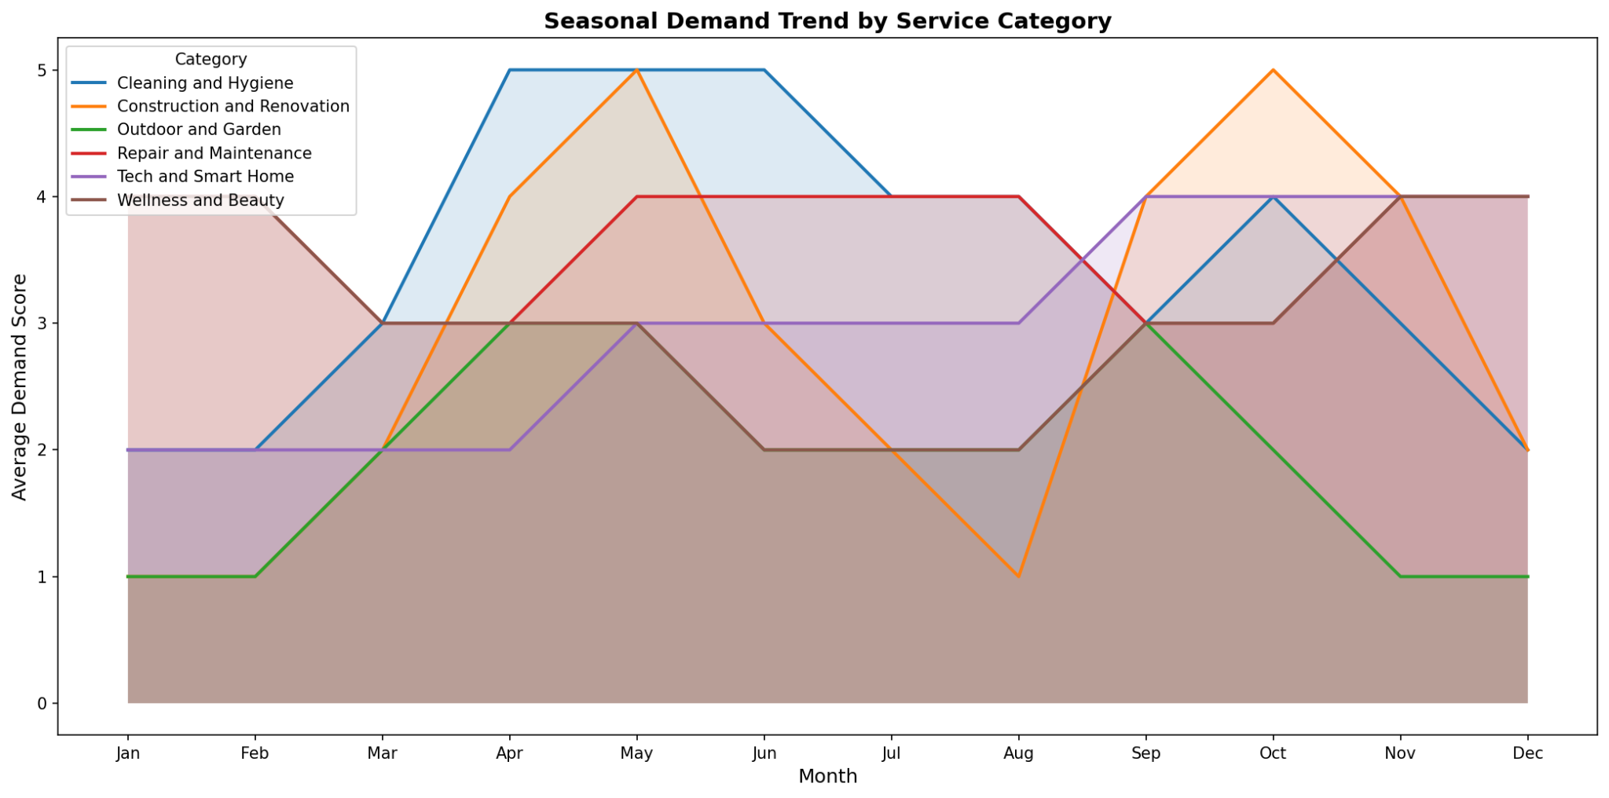
Average demand score trend across the year, by service category
Description: This chart tracks the average demand score trend over the year for each service category.
Insight: Most categories show a similar seasonal rhythm, with a few categories bucking the overall trend.

Slide 36
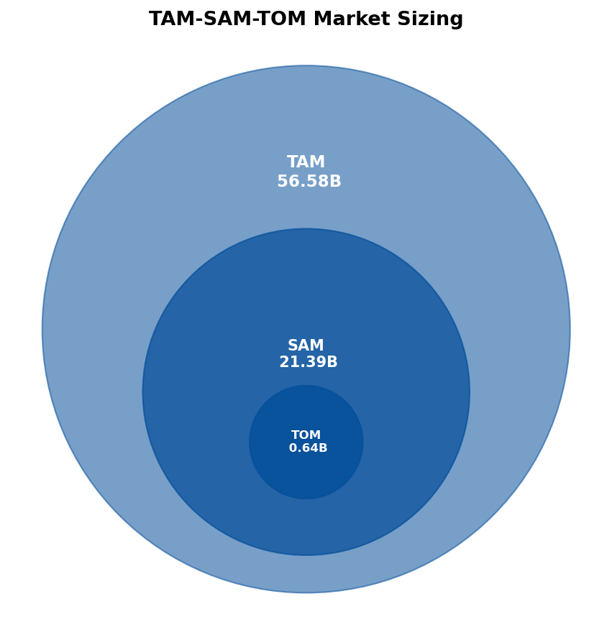
Overview of Total Addressable, Serviceable Available, and Target Obtainable Market
Description: This chart gives an overview of the three market-sizing tiers: TAM, SAM, and TOM.
Insight: The obtainable market is a small fraction of the total addressable market, setting realistic growth expectations.

Slide 37
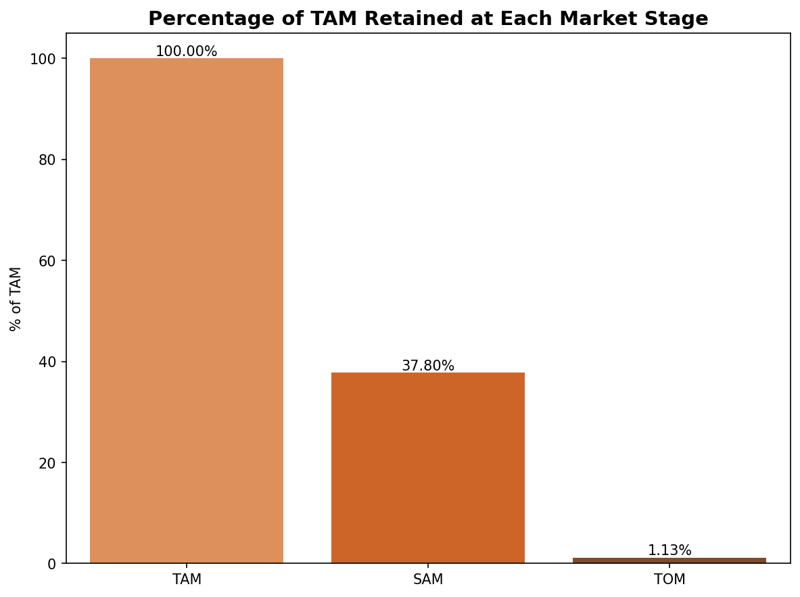
Funnel showing how market size shrinks from TAM to SAM to TOM
Description: This funnel chart shows how the market size narrows step by step from TAM down to SAM and finally TOM.
Insight: The steep drop from SAM to TOM highlights how much realistically capturable market shrinks after accounting for competition and reach.

Slide 38
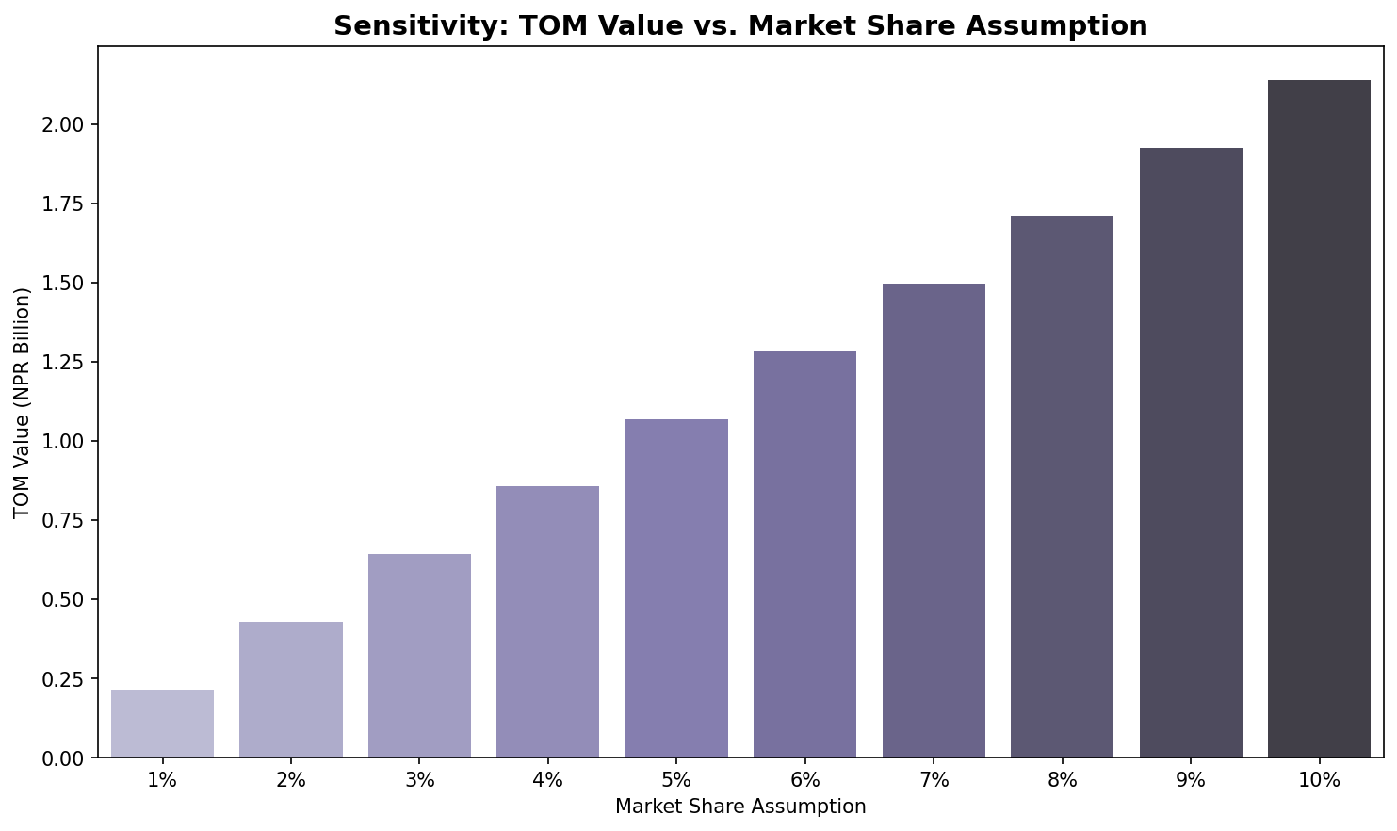
How the TOM value changes as the assumed market-share percentage varies
Description: This chart shows how the Target Obtainable Market value shifts under different assumed market-share percentages.
Insight: Even small changes in assumed market share significantly move the projected obtainable market size.

Slide 39
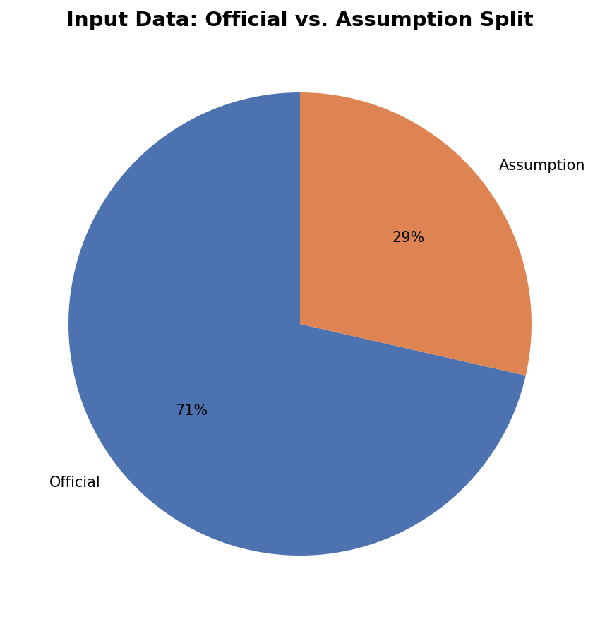
Share of input data based on official figures versus estimated assumptions
Description: This chart shows what portion of the analysis relies on official data versus estimated assumptions.
Insight: A meaningful share of the analysis depends on estimates, so findings should be read with that margin of uncertainty in mind.

Slide 40
Sources
Nepal Home Services: Google Search (official company websites)
Comparative Analysis: Google Search (official service provider websites)
Workforce Analysis: Google Search (official service provider websites)
Training Providers: Google Search (official training provider websites)
Airbnb Providers: Official Airbnb website
Yearly Services: Analysis based on seasonal demand patterns
SAM TAM TOM Analysis: Census 2021, NLSS IV (2022/23), and estimated calculations

Slide 41
Thank You

